Slide 1
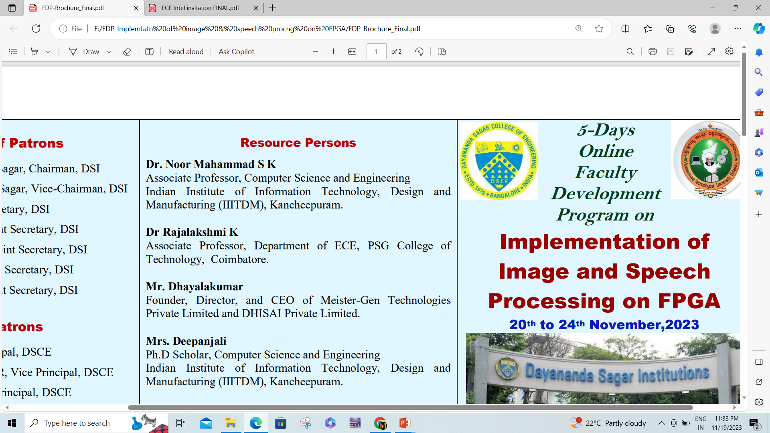
DAYANANDA SAGAR COLLEGE OF ENGINEERING Department of Electronics and Communication Engineering
Title of the Technical Seminar
Name of the UG Student
USN : 1DS
8th Semester
Course Name: Technical Seminar
Course Code:21EC81
Date / Time of Technical Seminar
Technical Seminar Section Coordinator name Guided by: Guide name Designation Designation

Slide 2
Contents
Introduction
Objectives
Literature Review / Background (Minimum five papers should be referred)
Methodology / Approach
Design / Implementation
Results & Discussion
Applications
Advantages & Limitations
Conclusion

